Slide 1


Object Oriented Design
Workshop: Scientific Computing 01, March 2022
Ida Marie Lassen, Center for Humanities Computing Aarhus

Slide 2
First we think, then we code…

Slide 3
4 fundamental concepts
Abstraction
Encapsulation
Inheritance
Polymorphism

Slide 4


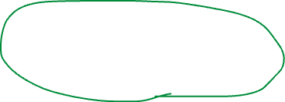
What have we learned so far?
Basic python
Flow control
Functions
Modules
>>> 5+5
10
>>> if x < 5:
... x += 1
>>> "Programming" + " is fun!"
'Programming is fun!'
>>> def add(a, b): return a + b
>>> if “fun” in text:
text.upper()
>>> colors = ["blue", "red", "purple"]
>>> for color in colors:
... print(color)
>>> from utils import adder

Slide 5






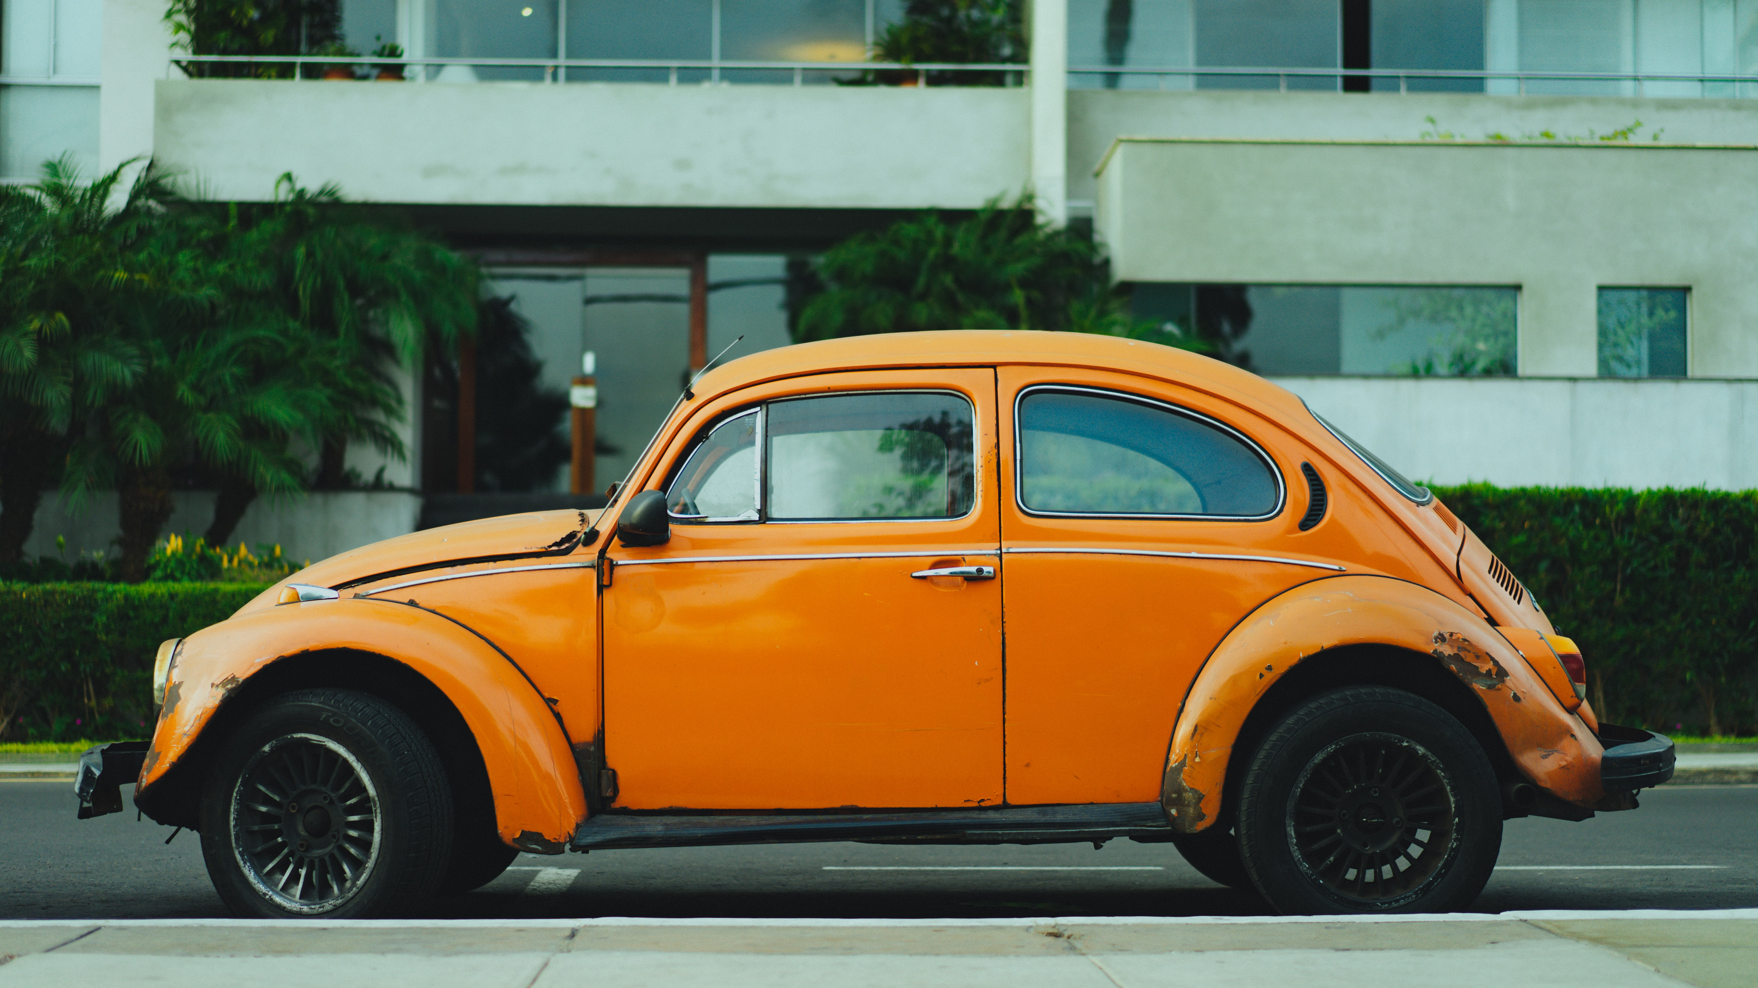
Grouping data – and associated functionality

Slide 6
Abstraction
Classes
An abstract blueprint.

Slide 7

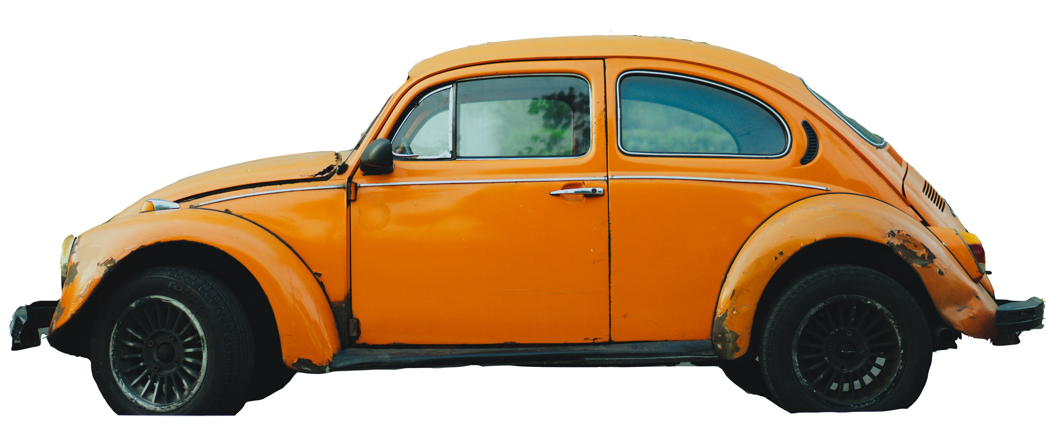
Abstraction
Classes
An abstract blueprint.
Collection of functionality.
Definitions for the data format and available procedures for a given class of object
Objects
Individual instances of a class.
Notes:
Definitions for the data format and available procedures for a given type or class of object

Slide 8
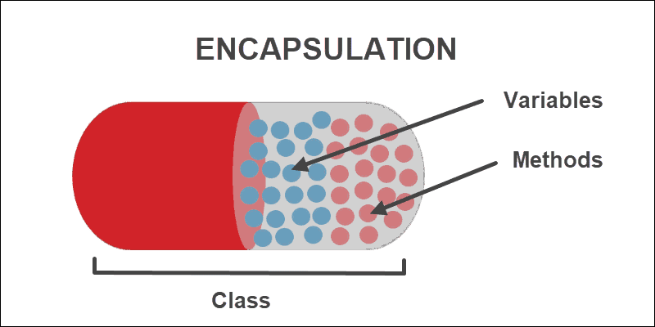
Encapsulation
One class – one role – one responsibility
With encapsulation we prevent external code from being concerned with the internal workings of an object.
Also known as decoupling.
Notes:
Fra wiki:
Encapsulation prevents external code from being concerned with the internal workings of an object. This facilitates code refactoring, for example allowing the author of the class to change how objects of that class represent their data internally without changing any external code (as long as "public" method calls work the same way). It also encourages programmers to put all the code that is concerned with a certain set of data in the same class, which organizes it for easy comprehension by other programmers. Encapsulation is a technique that encourages decoupling.

Slide 9
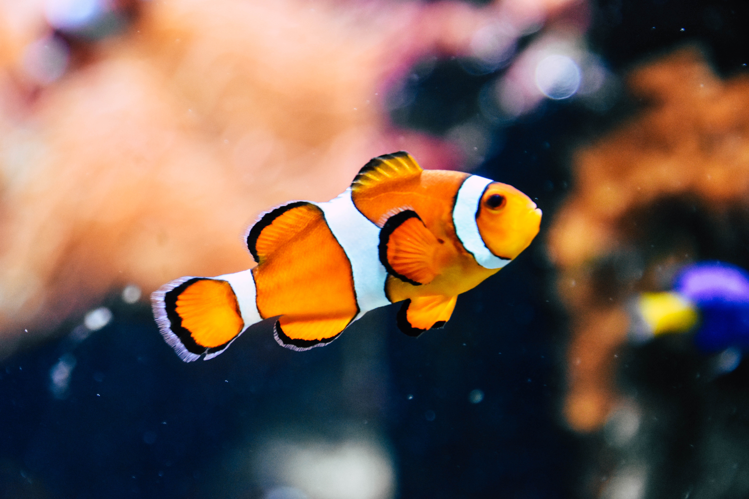
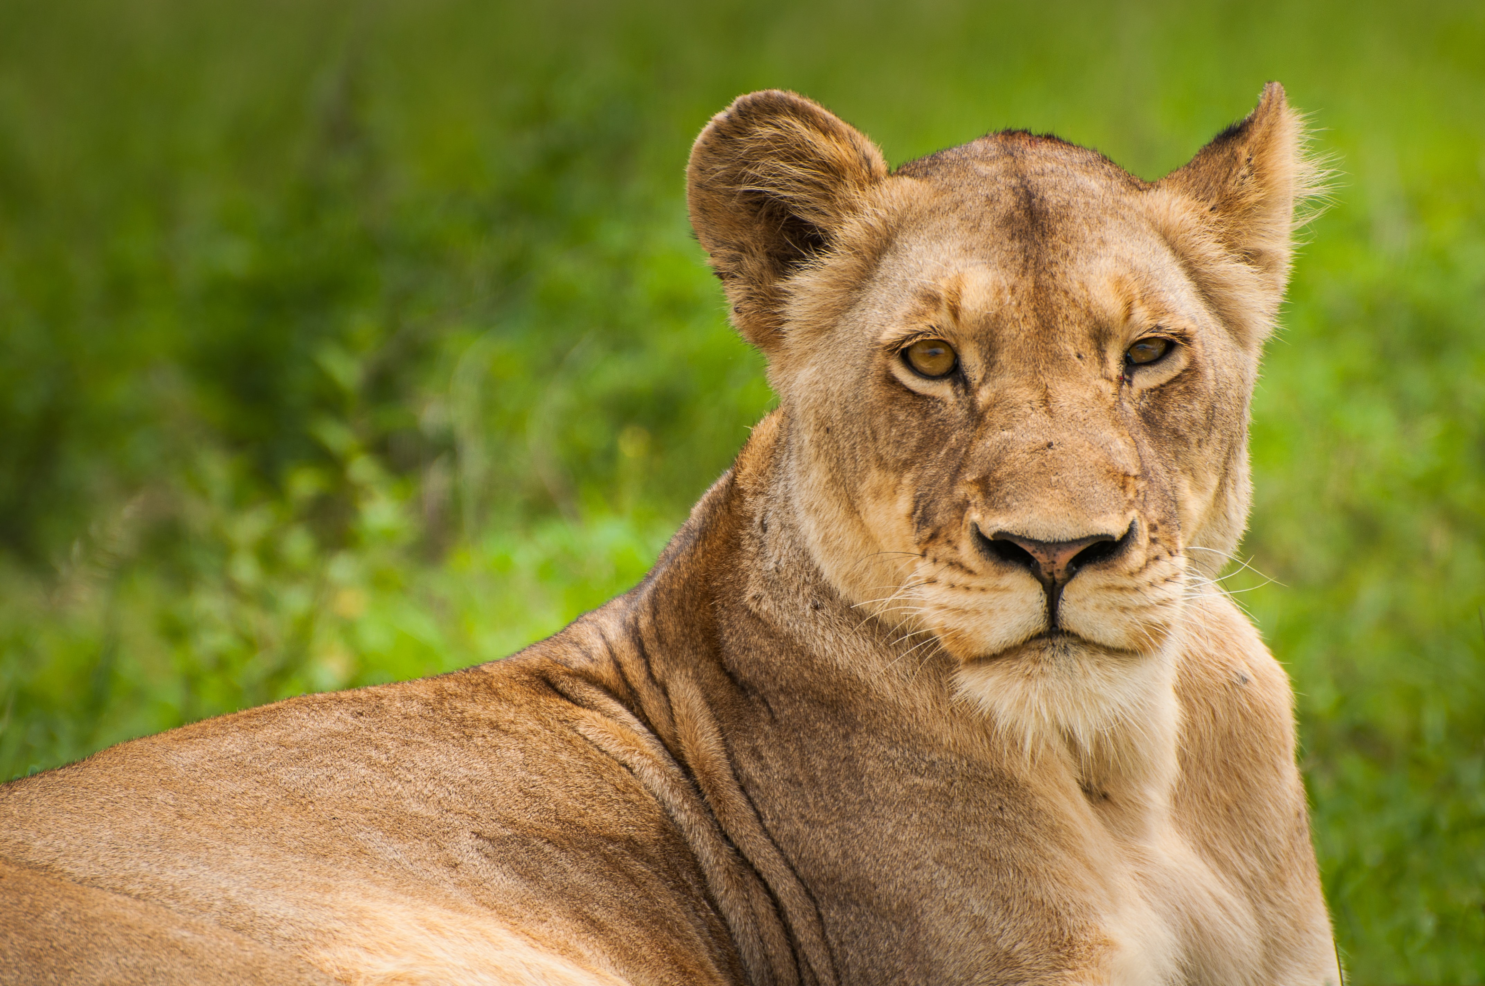
Inheritance – zoo example
Animal
Lion
+ age: int + sex: string + is_wild: boolean
+ eat( ) + run( )
Fish
+ age: int + sex: string + size: double
+ eat( ) + swim( )
Attributes
Methods

Slide 10
Inheritance – zoo example
Animal
+ age: int + sex: string
+ eat( )
Lion
+ is_wild: boolean
+ run( )
Fish
+ size: double
+ swim( )

Slide 11
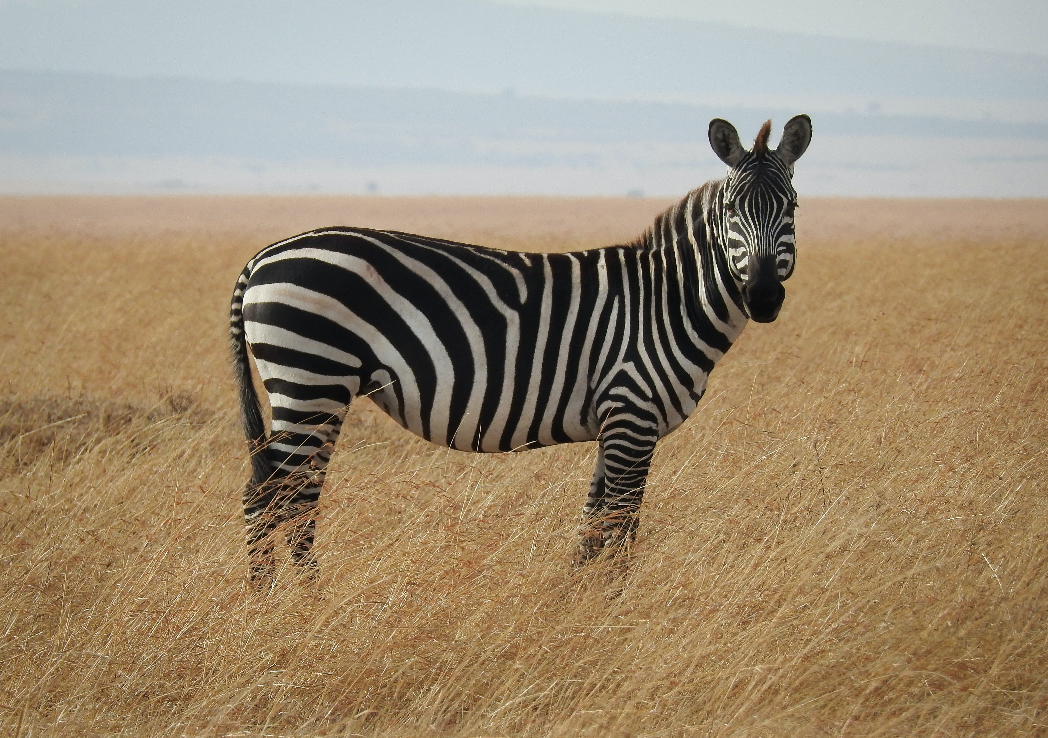
Inheritance – zoo example
Animal
+ age: int + sex: string
+ eat( )
Zebra
+ number_of_stripes: int
+ run_with_herd(int)
Lion
+ is_wild: boolean
+ run( )
Fish
+ size: double
+ swim( )

Slide 12
Inheritance
UML diagramme
Superclass
Animal
+ age: int + sex: string
+ eat( )
Attributes
Methods
Subclass
Zebra
+ number_of_stripes: int
+ run_with_herd(int)
Lion
+ is_wild: boolean
+ run( )
Fish
+ size: double
+ swim( )
Attributes
Methods

Slide 13
Mulitple Inheritance
Animal
+ age: int + sex: string
+ eat( )
Fish
+ size: double
+ swim( )
Shark
+ eat_surfer()

Slide 14
Inheritance – ”is a” relationships!
Superclass
+ attributes
+ methods
Parent class
Liskov’s Substitution Principle:
“You can use an instance of an object of a subclass whenever an object of the superclass is exptected"
Subclass
+ attributes
+ methods
Child class

Slide 15
Animal
+ age: int + sex: string
+ eat( )
Fish
+ size: double
+ swim( )
Liskov’s Substitution Principle:
“You can use an instance of an object of a subclass whenever an object of the superclass is exptected"
Shark
+ eat_surfer( )

Slide 16
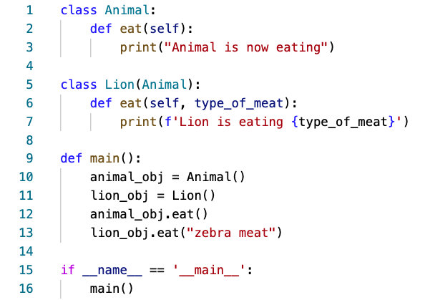
Polymorphism – the ability to take different forms
In simple words, polymorphism allows us to perform the same action in different ways.
Overloading: Overriding methods in subclasses.
Notes:
A subclass inherits all the methods from the parent class. However, in some situations, the method inherited from the parent class doesn’t quite fit into the child class. In such cases, you will have to re-implement method in the child class.

Slide 17
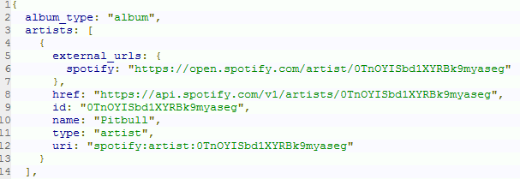
“real life” example – spotify data
Playlist
+ name: string + number_of_items: int
+ add_to_play_list(Playlist_item_type) + remove_from_play_list(Playlist_item_type) + start_playlist( ) + stop_playlist( )
Person
+ name: string + age: int
+ get_name()
Playlist_item_type
+ title: string + duration: double + times_played: int + artist: Artist
+ play( ) + stop( )
Album
+ title: string + artist: Artist + times_played: int + number_of_songs
+ release()
Artist
+ artist_name: string
+ create_art() + get_songs()
Song
+ genre: string
+ add_to_favorites()
Podcast
+ follow()

Slide 18
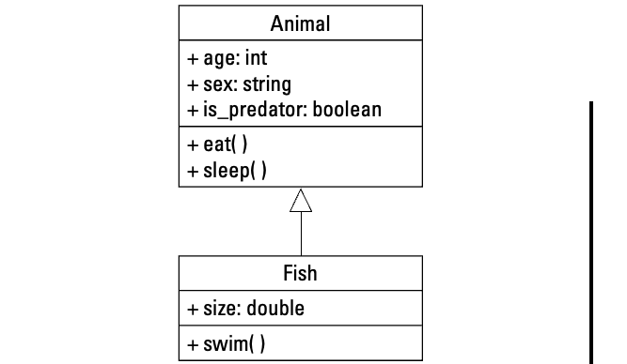
Recap
>>> some_text = “Programming is fun”
>>> some_list = [2,5,3,6,7,1]
>>> len(some_text)
18
>>> len(some_list)
6
Abstraction: generalize functionalities and properties into a class.
Encapsulation: encapsulate responsibility within one class and decouple it from other classes.
Inheritance: “is a” relationships where functionalities and properties are inherited.
Polymorphism: the ability of inherited methods to redefine behavior.

Slide 19
Pen-and-paper Design exercise
0. Decide on a “is a”-relationship you want to work with.
Design several classes – at least two subclasses and one superclass.
Identify the attributes and methods. Which ones belong in the superclass? And which in the subclasses?
Create a UML diagram to visualize your classes.
Tip: Keep it simple!

Slide 20
Object Oriented Programming in python

Slide 21
References
Images
Encapsulation: https://medium.com/future-vision/intro-to-oop-with-python-39ba63967e45
Car: Photo by Dan Gold on Unsplash
Spaceship: Photo by NASA on Unsplash
Book: Photo by Christian Wiediger on Unsplash
Person: Photo by Pablo Heimplatz on Unsplash
Student: Photo by Element5 Digital on Unsplash
Appointment: Photo by Element5 Digital on Unsplash
Reservation: Photo by Rafael Maggion on Unsplash
Lion: Photo by Sten Nijssen on Unsplash
Fish: Photo by Rachel Hisko on Unsplash
Zebra: Photo by Ron Dauphin on Unsplash
Spotify json: https://engineering.atspotify.com/2015/03/understanding-spotify-web-api/
Content
Phillips 2015, chp 1, Object-oriented Design
Phillips 2015, chp 2, Objects in Python

Slide 22
Further readings/online resources
Intro to Object-oriented Programming in Python: https://medium.com/future-vision/intro-to-oop-with-python-39ba63967e45
What is Polymorphism in OOPs programming?: https://www.edureka.co/blog/polymorphism-in-python/
UML class diagram arrow types: explanations and examples: https://www.gleek.io/blog/class-diagram-arrows.html
Python Design Patterns:
https://python-patterns.guide/

